Slide 1
Nutrient Intake Study
By: Chala Tafesa

Slide 2
How will carbohydrate intake impact both energy and weight

Slide 3
Variables

Slide 4
Independent Variables
Carbohydrate Intake:
Week 1 - Increased intake
Week 2 - Decreased intake

Slide 5
Dependent Variables
Weight
Energy levels

Slide 6
Data Collection
MyFitnessPal
Self-assessment (Energy Levels)
Daily Weight Tracking

Slide 7
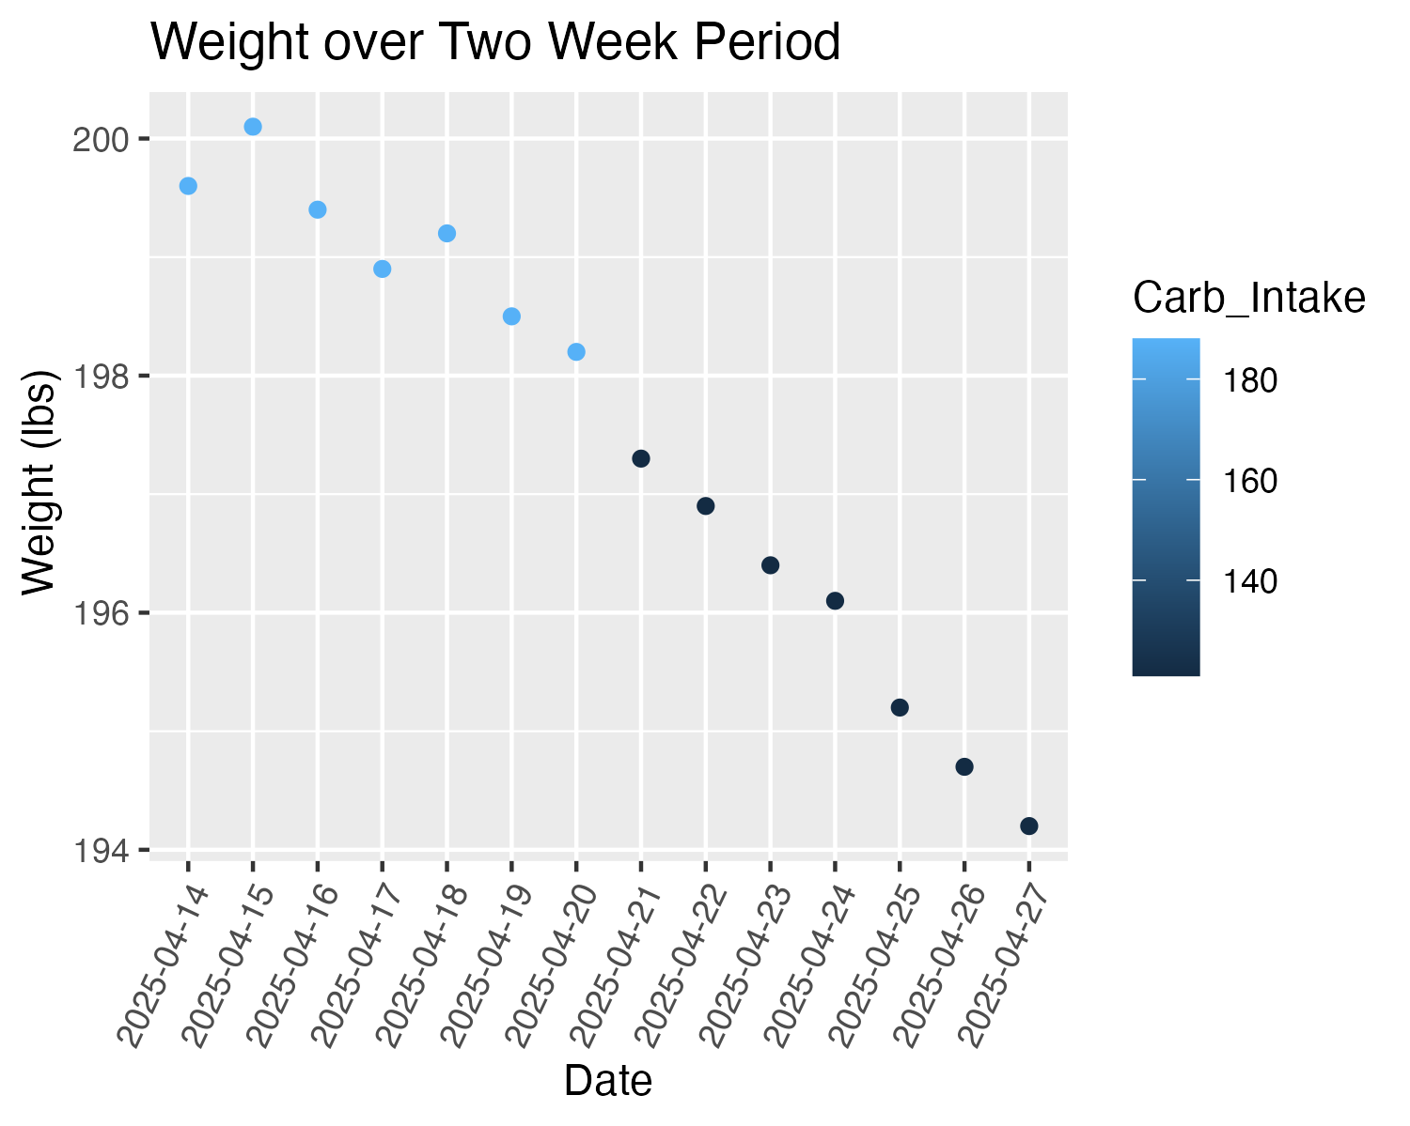
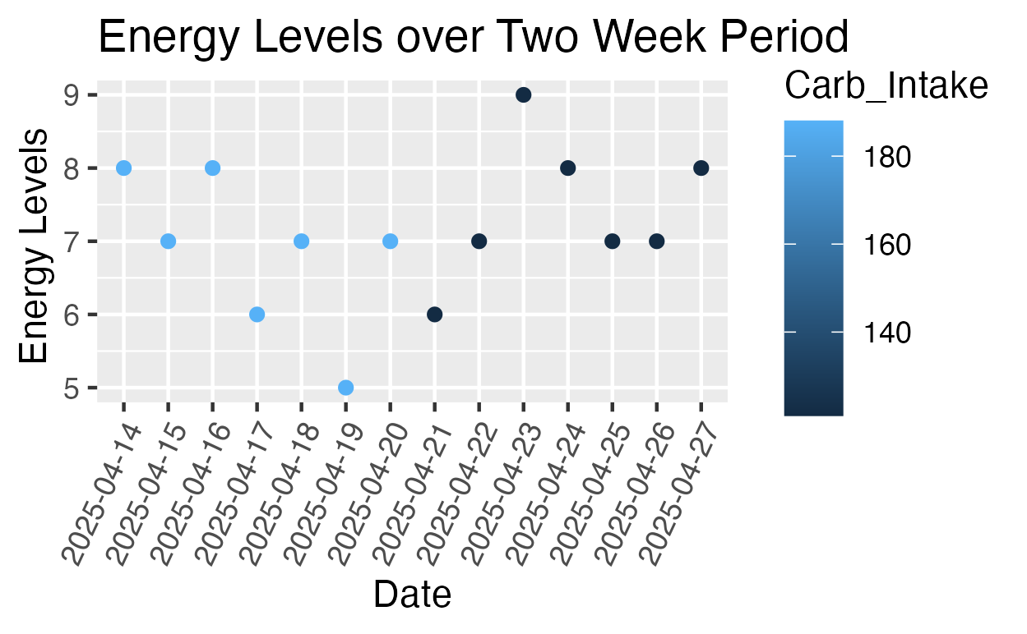
Data Collection

Slide 8
Hypothesis
Null Hypothesis: Decreased carbohydrate intake will not have a significant impact on energy levels and weight.
VS
Alternative Hypothesis: Decreased carbohydrate intake will significantly decrease energy levels and weight.

Slide 9
T-test for Energy Levels
T = 1.0445
DF = 11.902
P-Value = 0.1585
H0: μI = μD
Ha: μI > μD
Conclusion: P − value of 0.1585 which is greater than the significance level α = 0.05. Therefore, we fail to reject the H0. At 5% significance level we do not have sufficient data to conclude that my mean energy levels with increase carbohydrate intake is not significantly different than my mean energy levels with decreased carbohydrate intake.

Slide 10
T-test for Weight
T = -6.5723
DF = 9.4649
P-Value = 0.00004065
H0: μI = μD
Ha: μI > μD
Conclusion: P − value of 0.00004065 which is less than the significance level α = 0.05. Therefore, we reject the H0. At 5% significance level we have sufficient data to conclude that my mean weight with increase carbohydrate intake is significantly greater than my mean weight with decreased carbohydrate intake.

